Slide 1

MAJOR PROJECT
SUBMITTED BY :
JAHNVI JAIN

Slide 2
PROBLEM STATEMENT
WHO has hired you for working on the dataset of COVID 19. Aggregate data and within TWO days present your point of view to the joint committee on strategic planning to fight against COVID 19 on
A. Present state analytics – Uttar Pradesh
B. Correlation heatmap for various parameters
C. Build a model for predicting the confirmed and recovered on any dates past 15th July 2020
D. Build a classifier for severity gauging

Slide 3
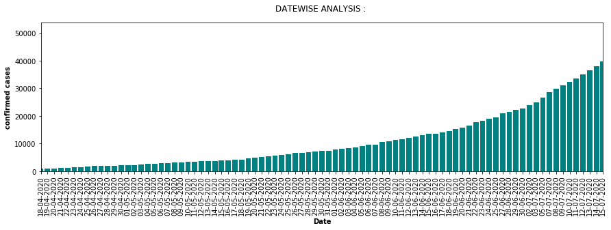
DATE WISE CONFIRMED CASES {UTTAR PRADESH}

Slide 4
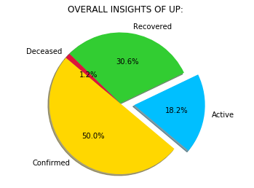
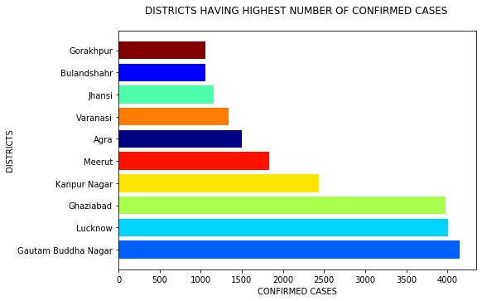
UP DATA ANALYSIS

Slide 5
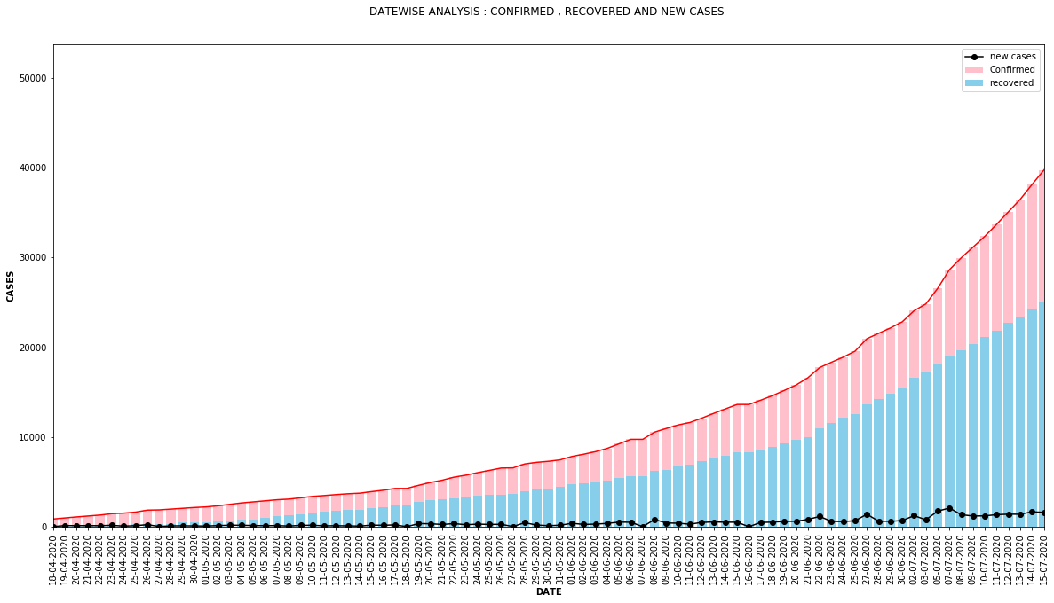
DATE WISE FROM TOTAL CONFIRMED , RECOVERED AND NEW CASES REPRESNTATION

Slide 6
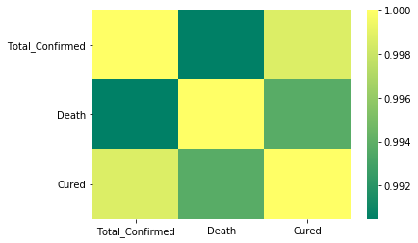
CORRELATION BETWEEN PARAMETERS {HEATMAP}
 | Total Confirmed | Death | Cured
Total Confirmed | 1.000000 | 0.990487 | 0.998679
Death | 0.990487 | 1.000000 | 0.993781
Cured | 0.998679 | 0.993781 | 1.000000

Slide 7
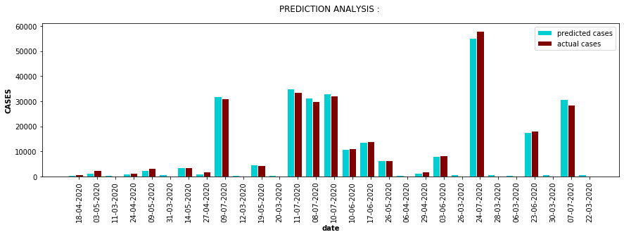
PREDICTION OF CONFIRMED CASES MODEL USED : Linear Regression R2 SCORE : 0.99573616

Slide 8
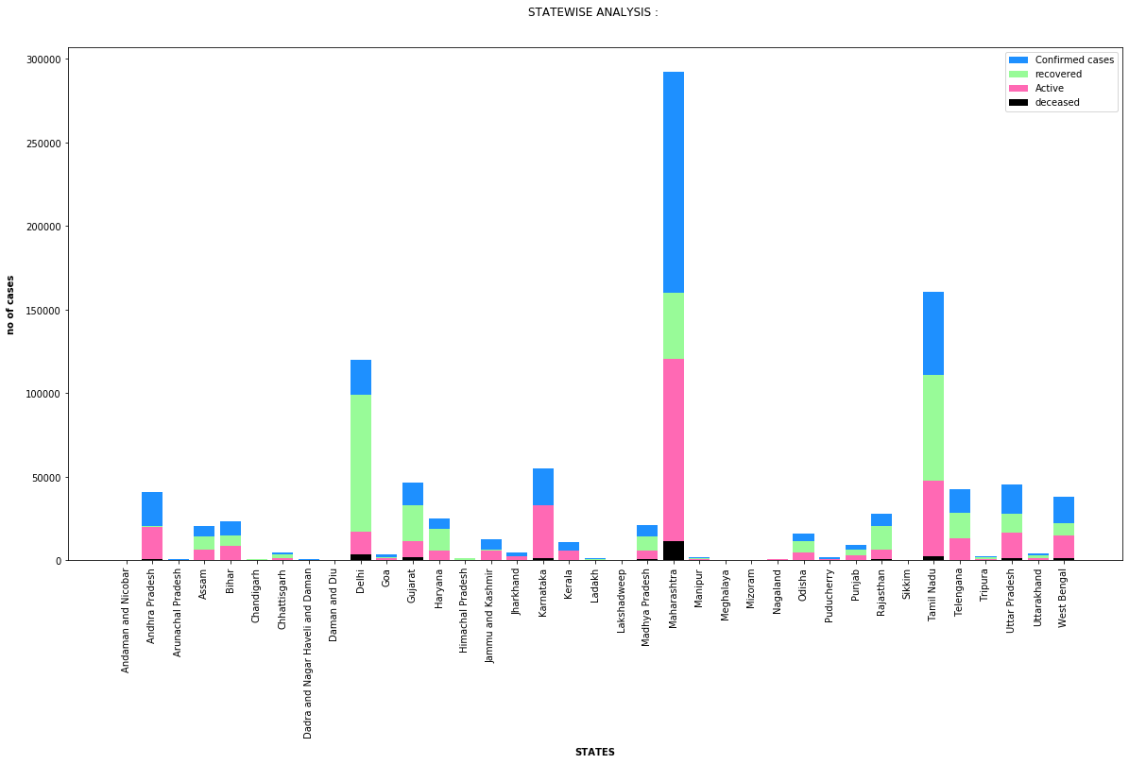
ANALYSIS OF STATES/UT’S

Slide 9
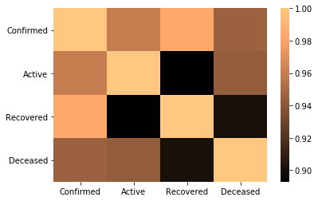
CORRELATION BETWEEN PARAMETERS OF ALL THE STATES OF INDIA {HEATMAP}
 | Confirmed | Active | Recovered | Deceased
Confirmed | 1.000000 | 0.959989 | 0.983172 | 0.945849
Active | 0.959989 | 1.000000 | 0.892905 | 0.943052
Recovered | 0.983172 | 0.892905 | 1.000000 | 0.901989
Deceased | 0.945849 | 0.943052 | 0.901989 | 1.000000

Slide 10
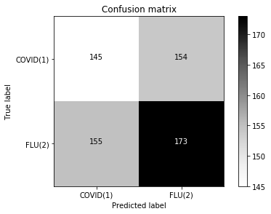
PREDICTION OF PATIENT STATUS MODEL USED : K-nearest neighbor Classifier ACCURACY ON TRAINING SET : 0.69
For covid(1)
True prediction : 145
False prediction: 155
For flu(2)
True prediction : 173
False prediction: 154

Slide 11
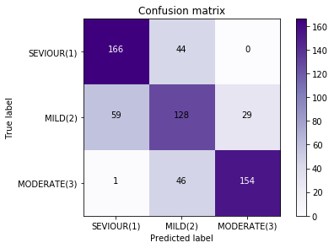
SEVERITY GAUGING CLASSIFIER MODEL USED : K-nearest neighbor Classifier ACCURACY ON TRAINING SET : 0.88
For seviour(1)
True prediction : 166
False prediction : 59+1=60
For mild(2)
True prediction : 128
False prediction : 46+44=90
For moderate(3)
True prediction : 154
False prediction : 29+0=29

Slide 12
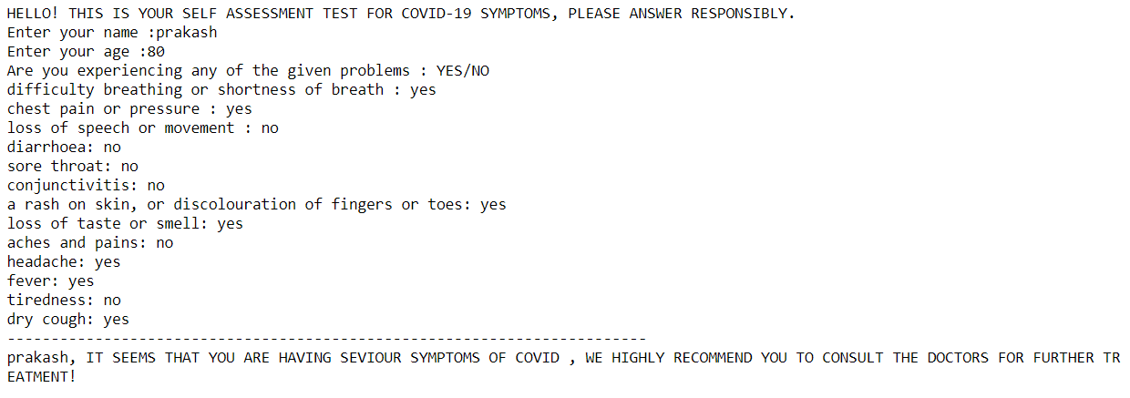
PREDICTOR FOR SEVERITY OF COVID -19 BY USER FILLED SYMPTOMS

Slide 13
THANK YOU

